Slide 1
Ripple Carry Adder Gate Delay

Slide 2
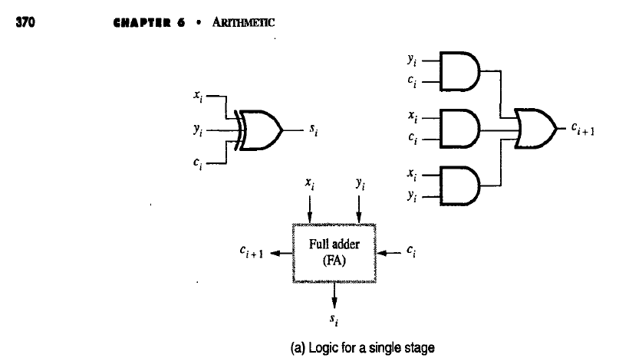
Delay in getting Ci+1 from time when Ci enters is 2 gate delays
Si available after 1 gate delay

Slide 3
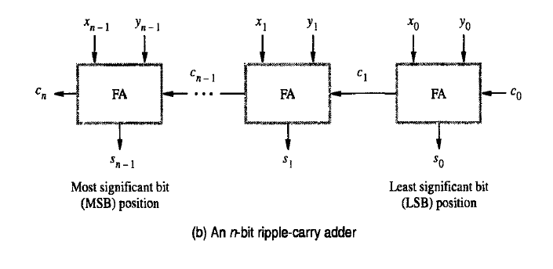
Cn got after 2n gate delays
Sn-1 got after 2n-1 gate delays from time when C0 enters RCA
n=8, 8 bit addition , sum available after 15 gate delays

Slide 4
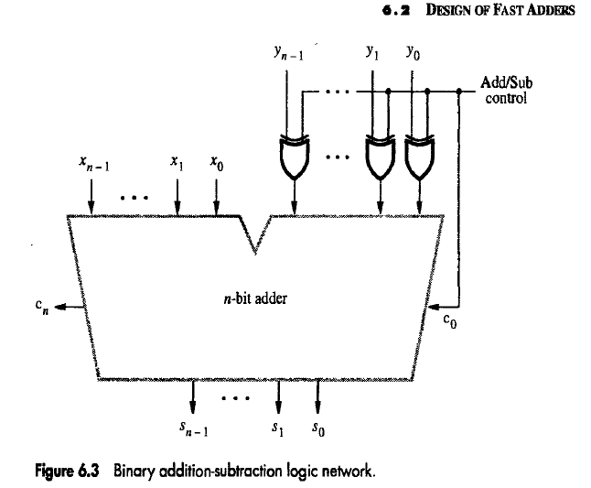

Slide 5
Gate Delays in Ripple Carry Adder/Subtractor
In adder/subtractor
Sum/difference available after 2n-1 +1(for the xor gate used in add/sub control= 2n gate delays
and Cn after 2n +1 gate delays
Plus another xor gate checks for overflow
So Cn available after 2n+2 gate delays
For 8 bit adding C8 available after 18 gate delays!!

